Slide 1




Award Winning Innovations
From Estimator Software LLC
Access from any PC-Mac, Tablet or Smart Phone
The Presentation is timed, or you may Left Click the slide to advance

Slide 2
Award winning
Secure-Safe Cloud Imposition at its best
Access from any PC, Mac, Tablet or Smart Phone
Learn in Minutes - No Setup Required
Calculates Best Layout for up to 4 Different Lots and Quantities
Maximizes Layout & Minimizes Waste
The Presentation is timed, or you may Left Click the slide to advance

Slide 3
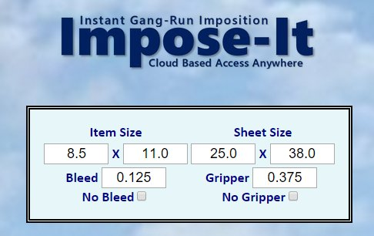
Award winning
Secure-Safe Cloud Imposition at its best
Step 1. Login and Set Item Size and enter Sheet Size
The Presentation is timed, or you may Left Click the slide to advance

Slide 4
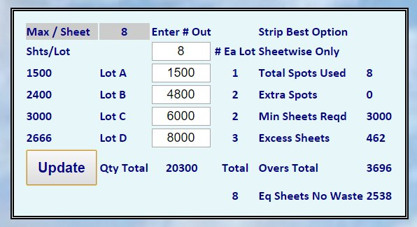
Award winning
Secure-Safe Cloud Imposition at its best
Step 2. “Enter # Out” and up to 4 Lots with Different Quantities, Then: UPDATE
The Presentation is timed, or you may Left Click the slide to advance

Slide 5
Award winning
Secure-Safe Cloud Imposition at its best
1-Time Setup Fee $55
Private Login and Password
Automatic Enhancements
Low Usage Fee $2.50/ Week*
* $125 / Year, $ 75 / 6 Months, $15/ Month. Credit or Debit Card Only
The Presentation is timed, or you may Left Click the slide to advance

Slide 6
Award winning
Secure-Safe Cloud Imposition at its best
Try it Today
Fast - Easy - Convenient
Cost-Effective
Multiple Quantity Imposition
For Additional Info:
Call: 203-682-6436
Or Write: ImposeIt@aol.com
The Presentation is timed, or you may Left Click the slide to advance

